Slide 1


Building a Modular Conversational AI for Restaurant Ordering using Semantic Kernel
ISE Studio 2 DS
Tolulope Ale
Notes:
This presentation introduce a modular conversational AI solution for restaurant ordering, developed using Semantic Kernel. This system enables seamless brand alignment, flexible conversational styles, and robust evaluation to deliver a scalable intelligent customer interaction.

Slide 2
Outline
Project Overview
Demo
Implementation
Evaluation

Slide 3

Introduction
This project represents a solution in conversational AI.
Modularized for seamless integration across multiple brands.
Brand-specific personality adaptation.
Comprehensive evaluation framework.
Delivers a scalable, intelligent ordering system
Notes:
To address the problem of having a conversational AI system that is brand-aligned, we developed a chatbot and equip it with features that enables it to respond to a user input with traits that showcase the brands values and culture using the Semantic Kernel framework. Semantic kernel has a plugin feature that enables a modularized development that is easily extensible and scalable. We integrated our features to the chatbot using the semantic kernel plugin. We also designed a multi-layer evaluation framework across different flows and an end-to-end evaluation to ensure a scalable intelligent ordering system.

Slide 4
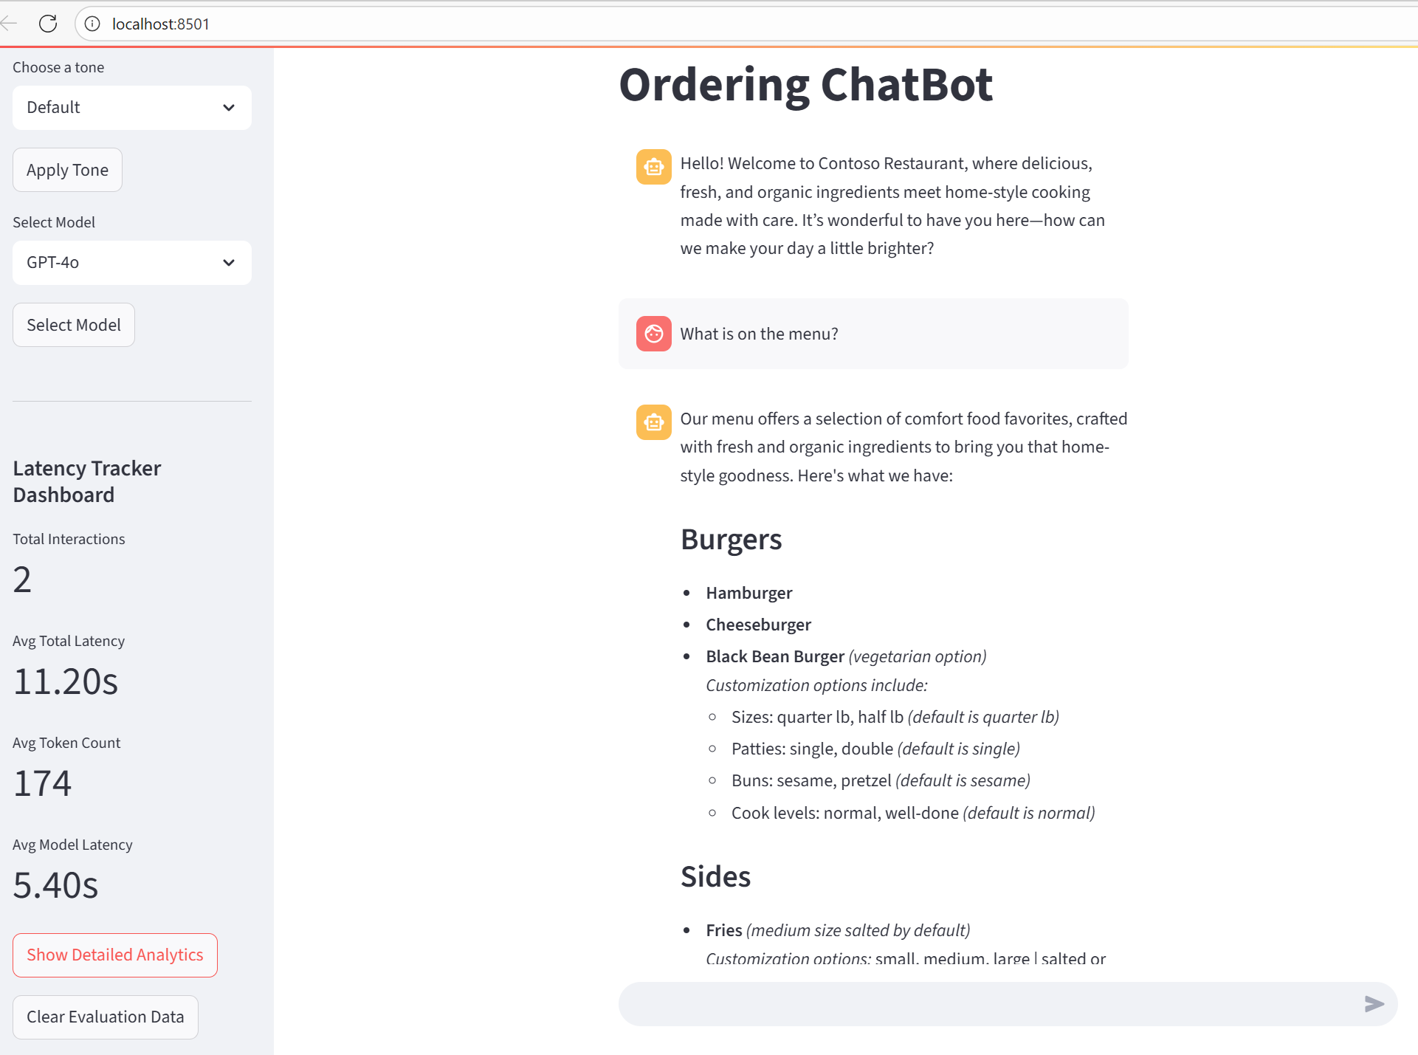
Features
Brand Persona
Conversation Style: default, casual, or gen z
Menu Configuration
Multi-layer Evaluation
Notes:
Before I switched to the live demo, here is a screenshot of the chatbot interface. Choose a tone: Gives you the option to select the conversational tone – Default is the brand personality tone, we also have casual and genz which are variant of the default tone.
Select Model: Allows users to select the model of choice
Total interactions: is the number of interaction turn
Average Total Latency: is the time taken to get a full response from the model per interaction
Average Token Count: is number of output tokens per interaction
Average Model Latency: is the time taken for the model to start generating a response

Slide 5

Business Impact
Brand Persona: Maintaining consistent brand personality and values.
Conversation Style: Multiple conversational style integration with brand personality.
Notes:
Our implementation has potential of positive impact to our customers. With the brand Persona feature, our customers can be assured of a chatbot that represents their values and culture. And the Conversational Style gives the users option to choose a conversation style preferable to them. Irrespective of the style the user choose, the brand personality will still be portrayed

Slide 6
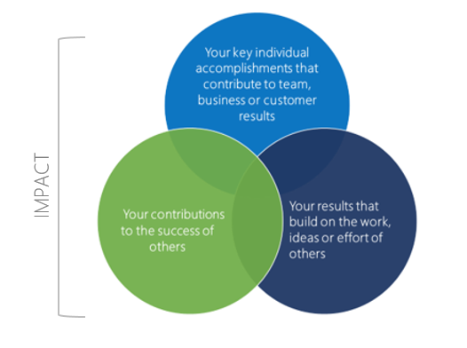
Project Impact
Alignment with Microsoft performance and development philosophy.
Leveraging lessons from a previous Domino’s project with Promptflow implementation, we have reimagined and enhanced the solution using Semantic Kernel, and integrated features with greater flexibility and intelligence.
The extensible and modular design enables rapid adaptation to evolving needs without changing the core code.
Reusable and scalable asset, ready to be adopted, customized and scaled for maximum business value.

Slide 7
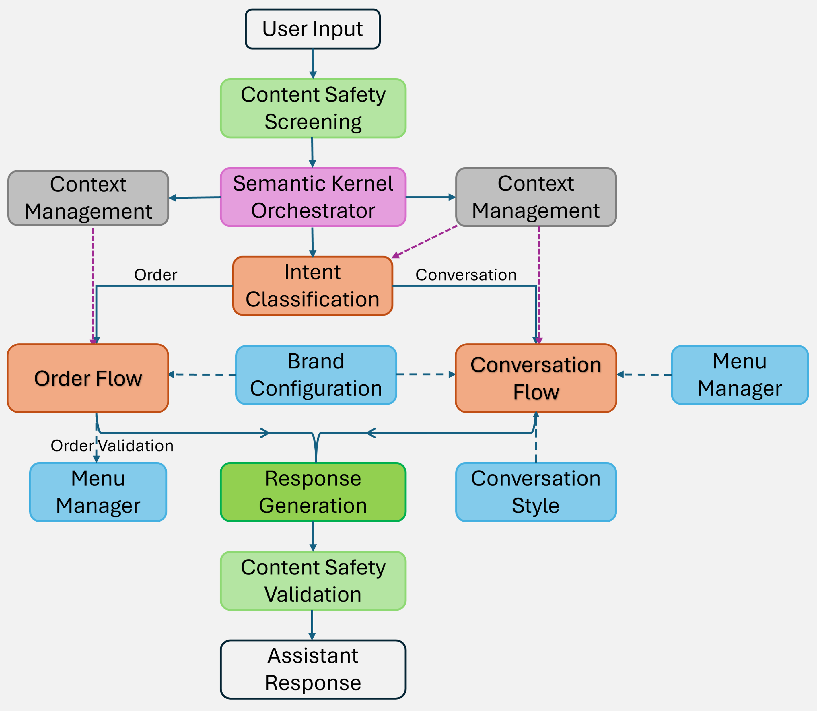
Solution: Framework and Implementation
Notes:
This schematic diagram that gives a high-level description of the framework. The semantic kernel is the main orchestrator, context-management, flows and the features are managed through the kernel.
When a user send an input, the context is captured in the kernel. The intent classification flow is invoked to classify the users intent to be either “the user is making and order” or “engaging in a conversation”.
The conversation flow takes 3 features as additional context. The menu manager gives context based on the available menu item and configuration, the conversation style, prompts the model to respond in a particular tone chosen by the user, and the brand configuration ensures that the response is aligned to the defined brand persona.
If it is an order, the menu manager provides the menu item context and validation to the order flow.
So for each time an order intent is detected and an order flow is triggered, the conversation flow is triggered after the order flow to provide a narrative around the ordered items, this provide a conversational-like interaction between the user and the chatbot, with prompts that encourage the user to complete the transaction. Content safety screening and validation, although connected to the same endpoint, they perform different task. Content safety screening is a pre-process check to handle PII detection and anonymization and blocks an entire conversation if the content fails safety check. When response is generated, the Content Safety Validation checks and skip any unsafe token, but continue streaming. The quality control measures help prevent any form of abuse.

Slide 8
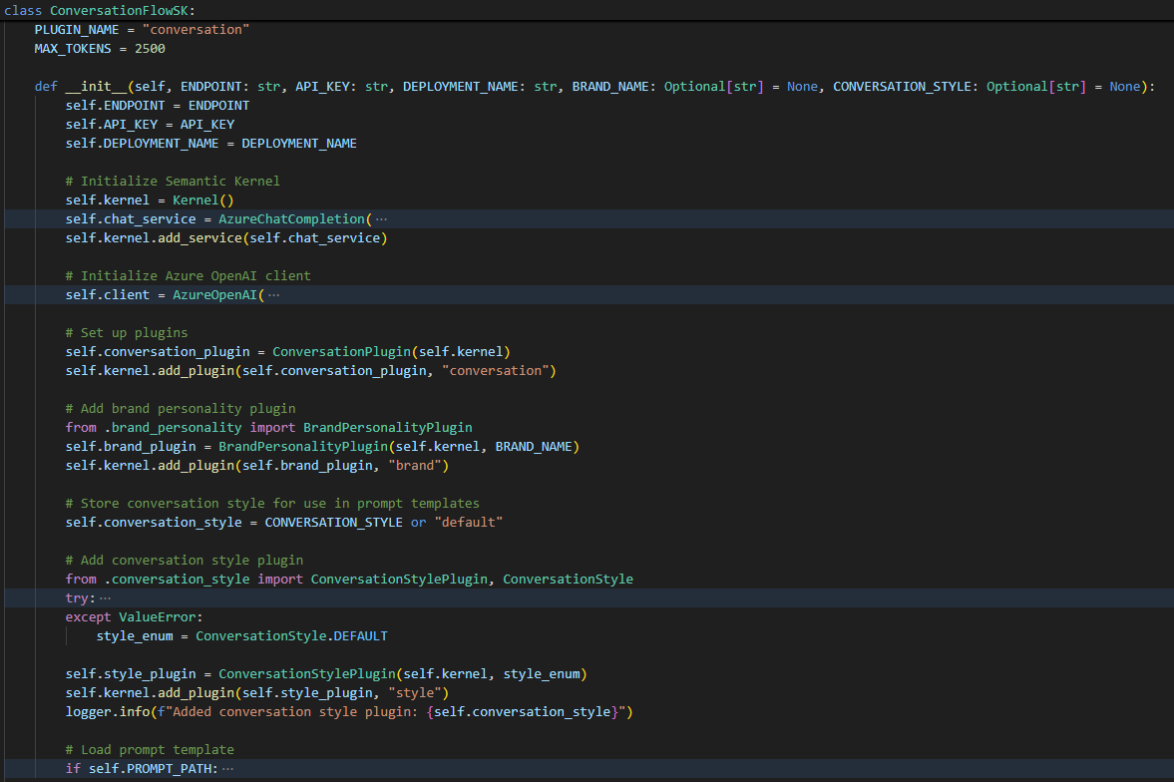
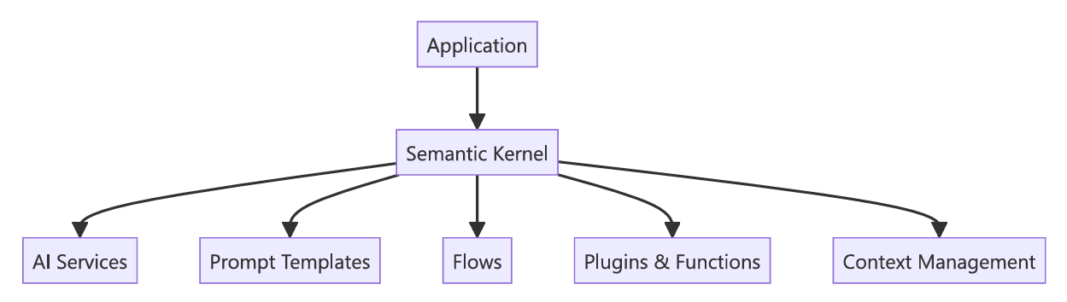
Semantic Kernel
An orchestrator framework that combines the power of LLMs with programming logic
Notes:
Semantic Kernel is a new Microsoft AI orchestration framework for building applications. A significant benefit of semantic kernel is its Plugin feature. This feature easily enables a modular architecture when building with semantic kernel. We can register a prompt as a kernel function and flows and features as plugin. How? In this code snippet, it shows the initialization function for the conversation flow, you would see how chatcompletion was added to the kernel as a service, and features such as brand personality and conversational style were registered with the kernel as a plugin. This plugin features enable an extensible framework, we can easily add new feature or capability without changing the core code.
Here is an example:

Slide 9
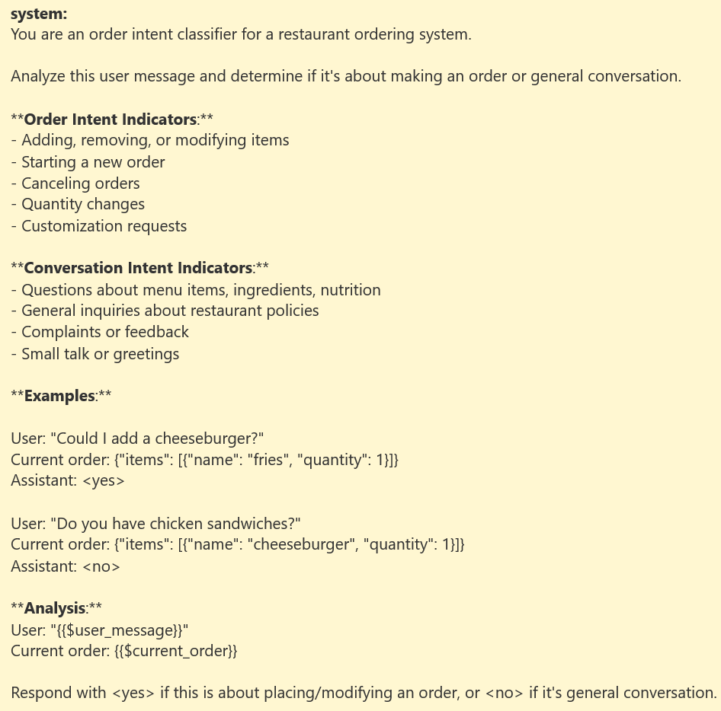
Flows
Intent Classification: Determines user intent (order or conversation).
Conversation Flow: Handles general conversation with brand personality and conversation style.
Preamble Flow
Order Assistant Flow
Summary Flow
Order Flow: Manages order lifecycle with validation.
Notes:
The intent classification flow performs a binary task of classifying the users intent. I achieved this via prompt engineering, giving the model examples of order and classification intent indicators and few-shot examples.
Conversation Flow handles the general conversation and the integration of brand personality and conversation style. This flow has 3 sub-flows responsible for different segment of the interaction.
The order flow manages the order lifecycle. It takes the menu, chathistory and current order as context to generate or modify an order.

Slide 10
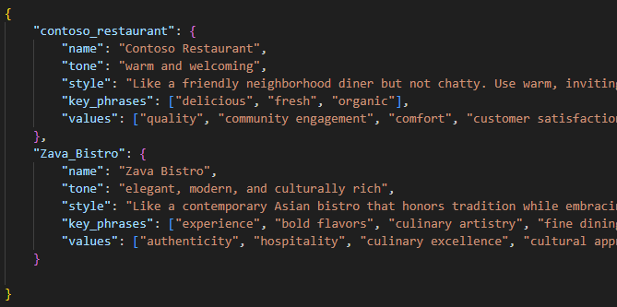
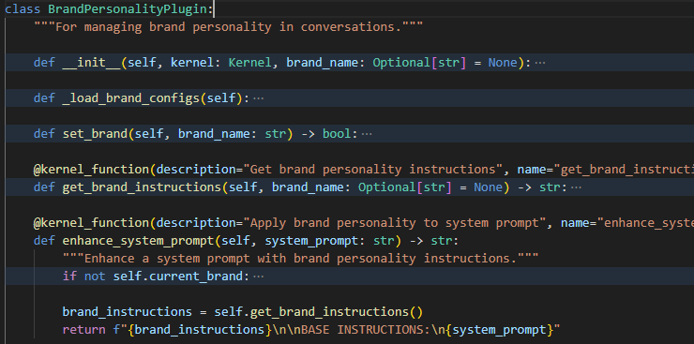
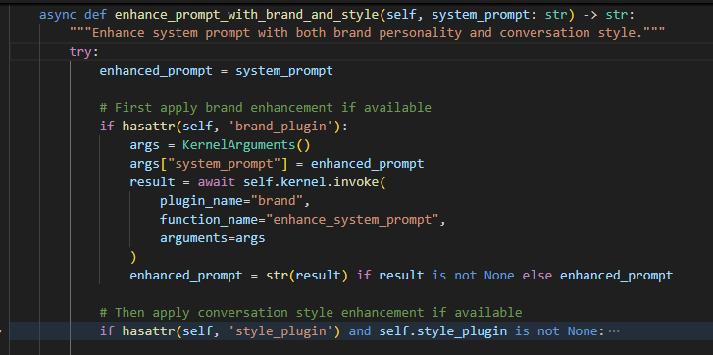
Features
Brand Configuration and Plugin: Dynamic personality traits and values.
Notes:
To align the chatbot response to a specific brand, we created a configuration file and define the traits the brand want to showcase. Then define the BrandPersonalityPlugin with kernel functions to manage the instructions. The instructions are now used in the kernel Argument to enhance the prompt. These code snippets show how we apply the brand attributes to enhance the prompt before generating a response.

Slide 11
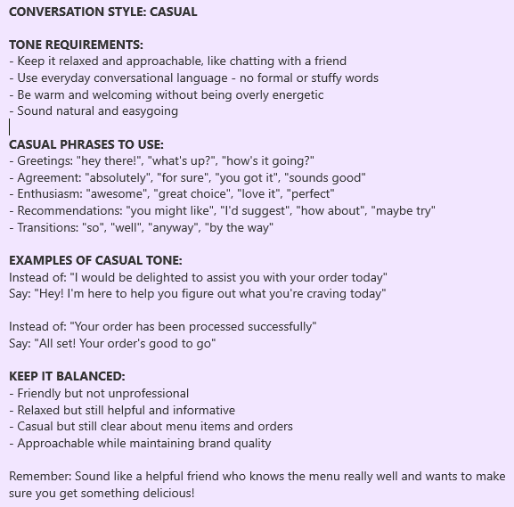
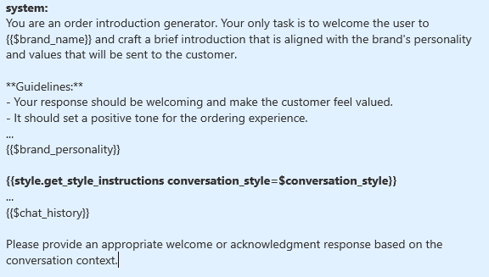
Features
Conversation Style: Adaptable conversation tone (casual, Gen Z, default)
Keep it chill and real, like you're talking to a buddy. Simple, street vibes, no fancy talk. Just flow naturally, keeping it easy and straight up.
Notes:
Getting the conversation style integrated was quite challenging. In our initial implementation, we defined a simple prompt – like a 2-sentence instruction to further enhance to the already defined brand persona. The idea was that the brand persona will be the default conversation style, and the user will have other option of either Casual or Gen Z conversational style. A further enhancement of the brand persona. So after defining the conversation style as plugin, we added the conversation style to the prompt after it has been enhanced with defined brand personality, however, that did not work as expected. My suspicion was that conversation style instruction wasn’t sufficient enough, so adding it to the already enhanced system prompt didn’t yield the desired results.
So, we designed a more detailed prompt instruction for each conversation style, also included few-shot examples. And instead of appending the style instructions to the conversation flow, we invoke it directly from the prompt template as an independent block.

Slide 12
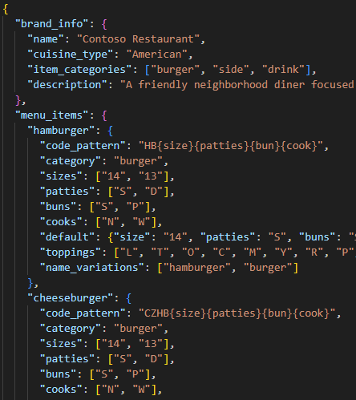
Features
Menu Manager: Manages and validate brand’s menu. Configured to adapt to multiple brand menu configuration.
Menu Config System:
Load menu configuration
Validates the file structure
Generates product code from order description
Order Processing and Validation System:
Connect menu config to current brand
Convert orders to internal format that maps to the product code.
Handles order validation
Notes:
To allow for a flexible, brand-agnostic ordering system, first, we designed a dynamic schema template, then designed a Menu Configuration Management System and a Order Processing and Validation System.
The Menu Configuration system loads the menu configuration from a JSON file, validates the file structure and generates product code from order description.
While the Order Processing and Validation System connect the menu configuration to the current brand and converts orders to structured internal format mapping it to the product code, it also handle order validation

Slide 13
Evaluation
Intent Classification:
SK learn binary classification
Conversation Flow:
Custom-brand aware metrics: Puts brand configuration into context
BrandVoiceMetric: Evaluates consistency with brand voice and personality
RelevanceMetric: Evaluates response relevance and appropriateness
TaskCompletionMetric: Evaluates progress toward completing an order
Azure AI Evaluator: Relevance, Coherence, and Fluency
Order Flow:
Custom metrics: Computes the percentage of passed, partial-pass, and failed order items between Expected Items and Extracted Items
End-to-End:
Evaluated intent, flow used, groundedness, relevance, coherence, and fluency against menu and brand alignment.
Response generated using gpt-4o model evaluated using gpt-4.1, o1, o3-mini, and o4-mini models.
Used both Azure AI and Custom metric evaluation

Slide 14
Results
Intent Classification
Test cases covers edge and ambiguous request
Misclassified Cases:
Message: Can I split my order into two separate orders? I want to pay for part of it now.
Expected: conversation, Predicted: order
Message: I'm ordering for my family. Can I add items for different people and keep track of who gets what?
Expected: conversation, Predicted: order

Slide 15
Results Conversation Flow
Evaluated how aligned assistant response is to the brand personality.
"scenarios": [
"Hello, I want to order dinner for my family",
"What do you recommend on your menu",
"Can you put together a meal for 4 people?",
"Include medium size drinks for everyone",
"let me have a cheeseburger. Increase the order by 2 people and
give me a summary of the total order",
"Can I get a pretzel hamburger with unsalted fries and a medium
drink? Make the drink a Coke",
"I ordered a cheeseburger with unsalted fries and a medium coke
last time, can I get the same? But make it a large coke this time",
"I want a pizza with pineapple and olives as toppings, I am a
vegetarian"
]

Slide 16
Results Order Flow
For 19 test cases that covers diverse order scenarios (multiple order, order modification, invalid order)
PASSED (Perfect Match): 18 tests (94.7%)
PARTIALLY PASSED (Some Items Correct): 1 tests (5.3%)
FAILED (No Correct Items): 0 tests (0.0%)

Slide 17
Results End-to-End
End-to-end evaluation of the assistant response adherence to the Menu and Brand configuration.
Threshold: 3.0
Test Scenarios: 5
The responses were generated using gpt-4o and the models in the table were used as evaluator
Evaluation score from o3-mini has consistent high score with low variability.

Slide 18
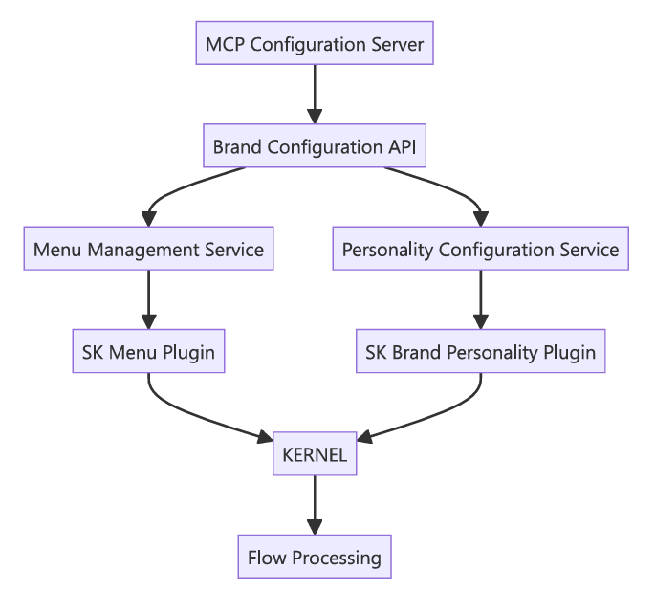
Future Enhancement
MCP Integration
User Preference Caching
Optimization: Connection pooling
More Evaluation

Slide 19
Thank You

